Slide 1
Boosting Algorithm Assignment

Slide 2
Boosting algorithm
Boosting algorithms are machine learning techniques that combine weak learners to improve the accuracy of predictive models.
They are particularly useful for complex datasets and challenging prediction tasks
They are some boosting algorithms are
Adaboost algorithm
Extreme gradient boosting (XGBoost)
LG boosting algorithm
Catboost algorithm

Slide 3
ADABOOST ALGORITHM
Adaptive Boosting is an ensemble learning and it is to iteratively train the weak classifier on the training dataset with each successive classifier giving more weightage to the data points that are misclassified.
The final AdaBoost model is decided by combining all the weak classifier that has been used for training with the weightage given to the models according to their accuracies.
The weak model which has the highest accuracy is given the highest weightage while the model which has the lowest accuracy is given a lower weightage.

Slide 4
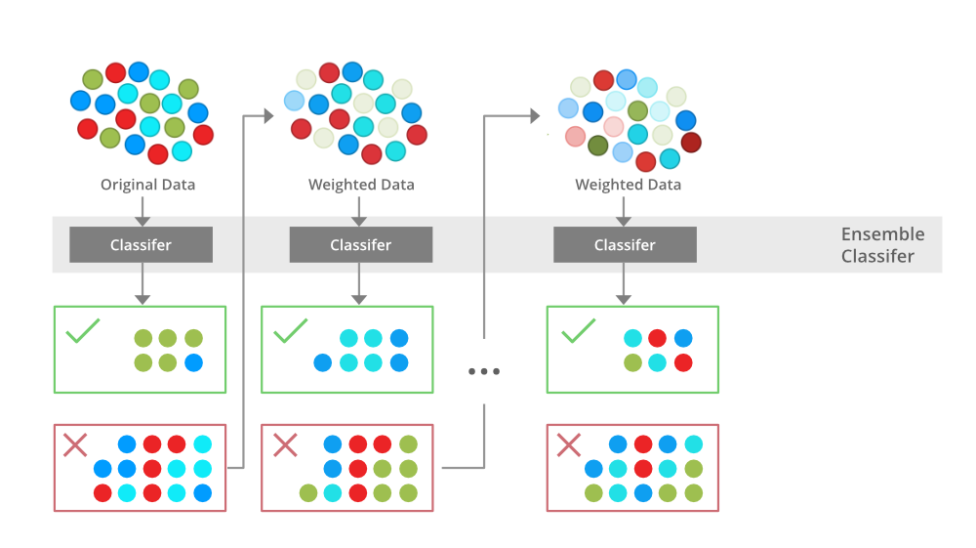

Slide 5
AdaBoost Algorithm how it works
Step1 – Initialize the weights
Step2 – Train weak classifiers
Step3 – Calculate the error rate and importance of each weak model M_{k}
Step4 – Update data point weight for each data point W_{i}
Step5 – Normalize the Instance weight
Step6 – Repeat steps 2-5 for K iterations

Slide 6
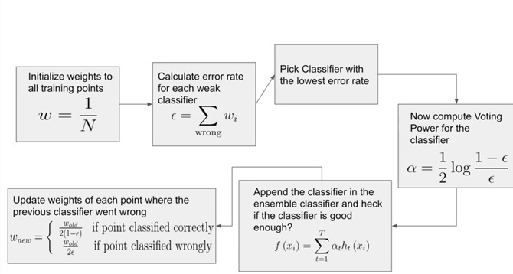

Slide 7
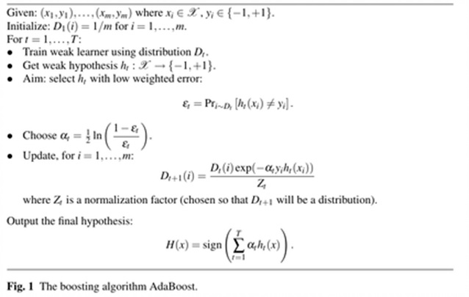

Slide 8
Extreme gradient boosting
XGBoost is an optimized distributed gradient boosting library designed for efficient and scalable training. It is an ensemble learning method that combines multiple weak models to produce a stronger prediction
It has become one of the most popular algorithms due to its ability to handle large datasets and ability to achieve state-of-the-art performance
The key features is its efficient handling of missing values and support parallel processing, making it possible to train large datasets in a reasonable amount of time.

Slide 9
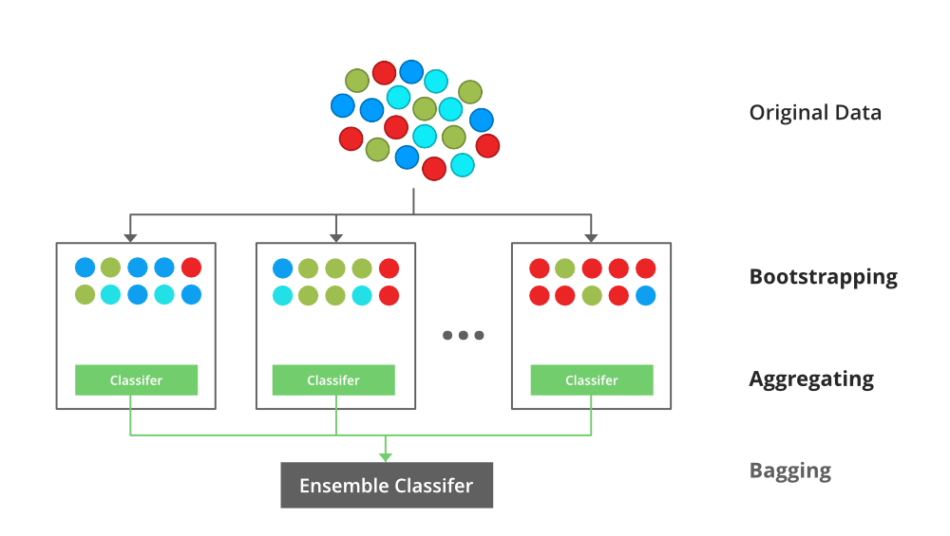

Slide 10
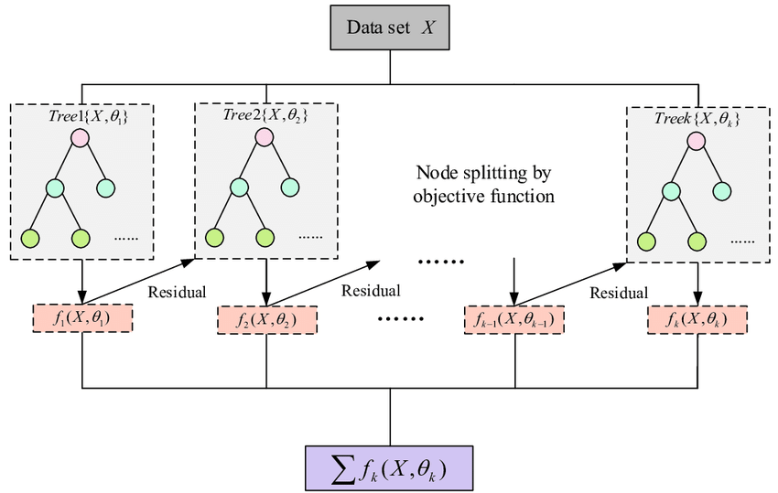

Slide 11
XGBoost Model Benefits
High accuracy: It delivers high accuracy and consistently outperforms
Scalability: It handle large datasets with millions of rows and columns
Efficiency: The design ensures quickly train models on large datasets.
Flexibility: It supports regression, classification, and ranking problems.
Regularization: Here regularization techniques to avoid overfitting and improve generalization performance.
Interpretability: It provides feature importance scores that can help most important feature for making predictions.
Open-source: XGBoost Model serves as an open-source library.

Slide 12
LG BOOSTING ALGORITHM
Light Gradient Boosting Machine is high performance gradient boosting framework designed for specially speed and accuracy
LG is known for its excellent speed and low memory consumption, histogram based techniques and leaf-wise tree growth.
How LightGBM Works:
Distribution is used by LG to bucket data into bins. Instead of using every data point, the bins are used to iterate, calculate the gain, and divide the data.
To reduce dimensionality reduction and speed up processing,

Slide 13
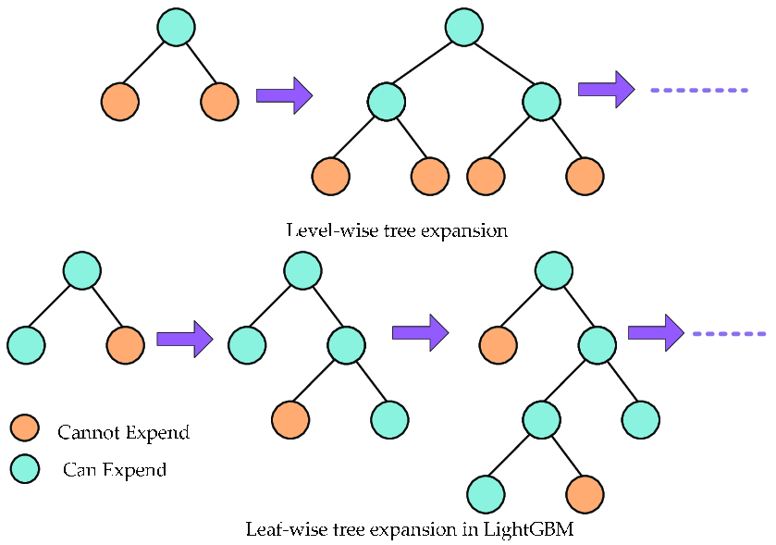

Slide 14
